Slide 1

Identifying Factors Contributing to Spatial Patterns of Mule Deer-Vehicle Collisions
Department of Biology, Southern Utah University
Karl Jarvis, Darby Adams, Natalie Barlow, Michael Christiansen, Arsene Mugisha

Slide 2
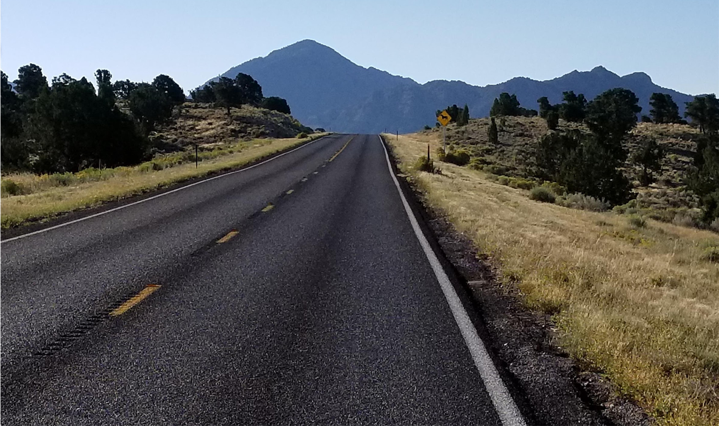

Slide 3
Introduction
In the U.S. the public spends about 70 billion hours driving
  Average driver making 2.2 trips per day, 50.6 min on road and driving 31.5 miles
Costs due to Wildlife Vehicle Collisions (WVCs) exceeds $7.5 M annually (Utah)
Harms both people and Wildlife
Mule Deer (Odocoileus hemionus hemionus)

Slide 4
Introduction: Hypothesis
Topographic Roughness
Fencing
Vegetation
  are drivers of WVC

Slide 5
Methods
Deer Vehicle Collisions Data (UDOT)
Topographical Roughness Data
    Extracted from digital elevation model
Roadside Vegetation Data
    LandFire
    Quadrats (Only for HWY 56)
Fence Data
    Quality and Location

Slide 6
Methods
Linear models
Model selection in the R environment
AIC Criterion

Slide 7
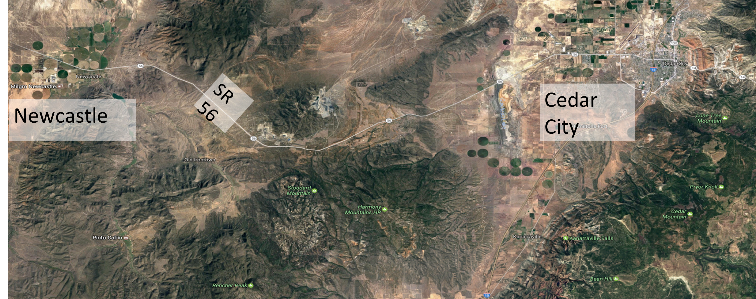
Study Area HWY 56

Slide 8
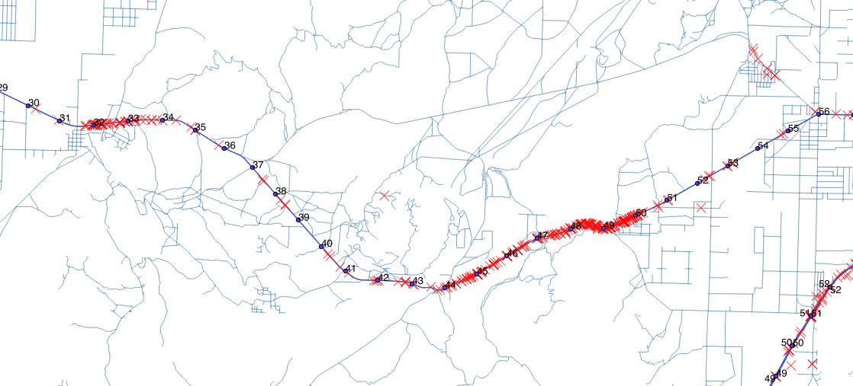
WVC Location HWY 56

Slide 9
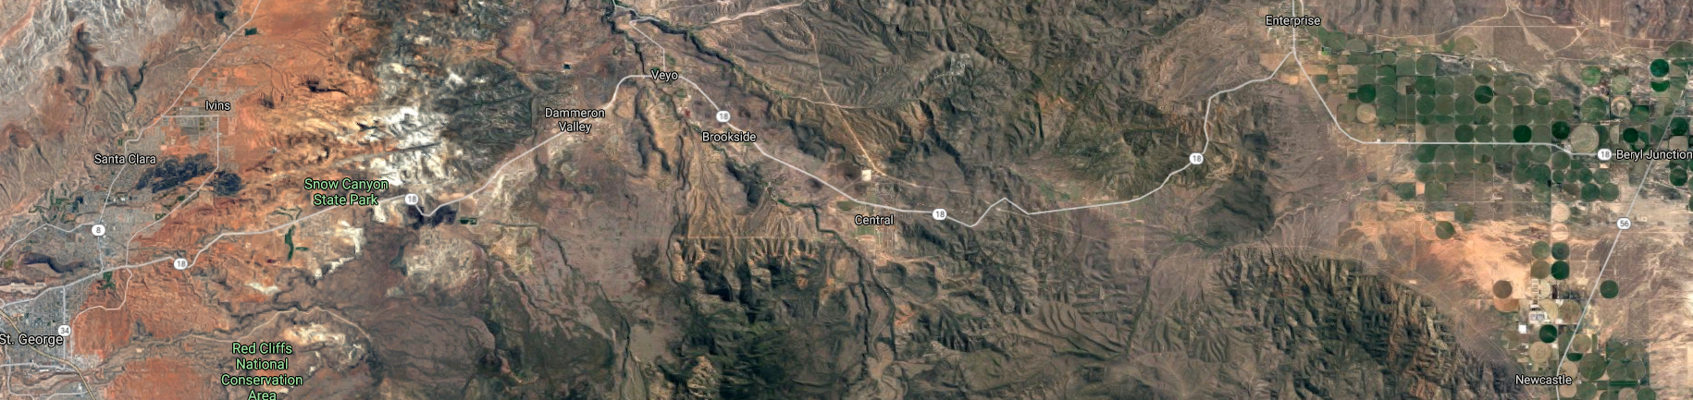

Study Area HWY 18
St. George
SR 18
Newcastle

Slide 10
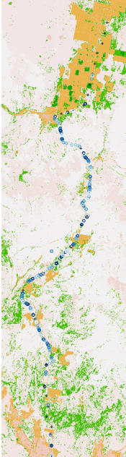
WVC Location HWY 56

Slide 11
Other Roads In Progress
HWY 21
HWY 20
HWY 130

Slide 12
Results
Model | AICc | ΔAICc | w
Veg | 145.64 | 0 | 0.642
Tree, Shrub, Veg | 148.83 | 3.182 | 0.131
Veg (0+5+10+15+20m) | 149.10 | 3.458 | 0.114
Tree, Shrub, Veg, Fence | 149.46 | 3.821 | 0.095
Tree, Shrub, Fence, Veg, TRI | 152.73 | 7.086 | 0.019
Null | 191.48 | 45.83 | 0.000

Slide 13
Results

Slide 14
Conclusions
Vegetation was the most accurate predictor WVCs.
Other good indicators:
  Trees, Shrubs, Fence, Topographic Roughness
Affect size small
Vegetation, Topography, Fencing do influence WVC distribution
More Research

Slide 15
Future Work
Sight Index
Distance to Water Sources
Migration Patterns

Slide 16
Acknowledgments
This work was supported by an L.S. and Aline W. Skaggs Research and Scholarship Award and the Gibson Grant.
The image in figure 1 is courtesy of Google Inc.
https://aaafoundation.org/wp-content/uploads/2018/02/18-0019_AAAFTS-ADS-Research-Brief.pdf

Slide 17
Questions?

